Slide 1
Capstone Project Car Accident Analysis
Applied Data Science Capstone by IBM/Coursera
By : Mostafa Eltayeb

Slide 2
Table of contents
Introduction: Business Problem
Data
Visualization
Methodology
Analysis
Results and Discussion
Conclusion

Slide 3
Introduction: Business Problem
Car Accidents is one of major cause of mortality around the world ,
Sometimes, accidents occur for a combination of reasons, from bad visibility to unsafe road design, or other drivers lack caution.
While the causes of accidents can vary, the consequences are often the same, resulting in everything from vehicular and property damage to serious injuries.

Slide 4
Introduction: Business Problem
We need to reduce the rate of accident by previous warning the driver and give them more info and precautions .
With the aid of previous year’s Datasets of similar accidents and weather conditions we can :
predict the severity of accidents expected and prevent them or
have a quick response .

Slide 5
Data
Based on definition of our problem, factors that will influence our decission are:
--data collected from previous collisions at last year/years
--current weather condition , driver , road .

Slide 6
2.1 Data sources
We have a dataset
name : Collisions—All Years
provided by : SPD and recorded by Traffic Records.
about : the impact of traffic

Slide 7
2.1 Data sources
After Investigatigation : dimentions , Types , columns ,rows
Result :
Dataset contain (194673 rows , 38 columns ) also :
1- redundancy like 'SEVERITYCODE.1','SEVERITYCODE‘ Columns
2- missing values 3- Uneeded columns in our investigation

Slide 8
2.2 Data cleaning
1- Remove redundancy : dropping column 'SEVERITYCODE.1
2- missing values : Drop Null values 3- Unneeded columns in our investigation

Slide 9
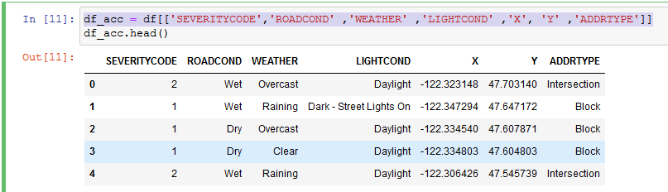
2.3 Feature selection
3- Select only column we need in our investigation

Slide 10
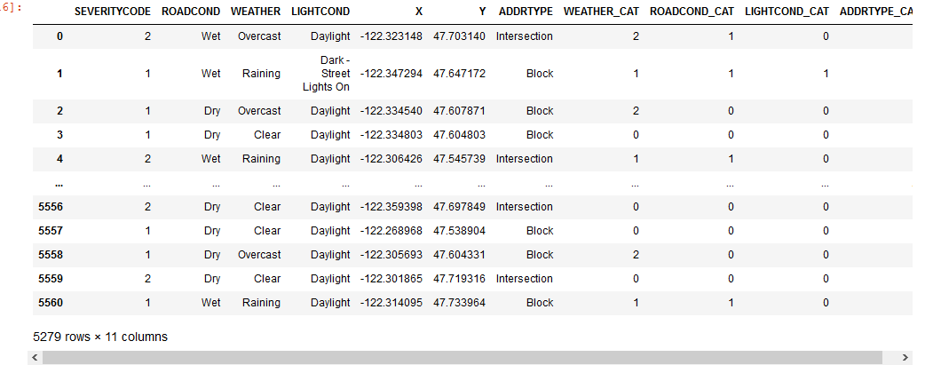
Label encoding
we need to use label encode to make dataset ready for analysis

Slide 11
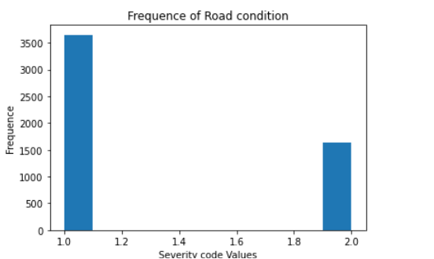
Data Visualization
Our Target Column is
SEVERITYCODE
We notice that data is unbalanced
And need to be balanced
To prevent bias

Slide 12
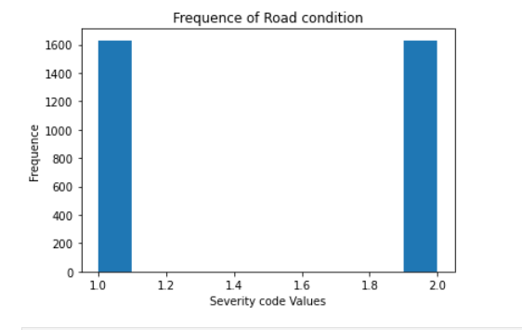
Data Visualization
Our Target Column is
SEVERITYCODE
Here dataset is balanced

Slide 13
Methodology
Classification Model
1- K-Nearest Neighbors
2-Decision Tree
3-Support Vector Machine
4-Logistic Regression

Slide 14
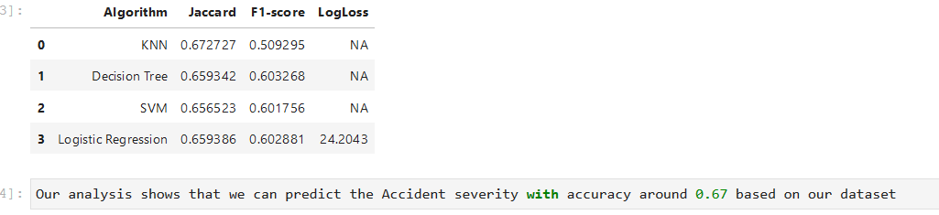
Result

Slide 15
Discussion
Our analysis shows that we can predict
the **Accident severity** with accuracy around **0.67**
based on our dataset
using classification models like decission tree , k-value ,Logistic Regression

Slide 16
Conclusion and future directions
Purpose of this project was to analyzed the relationship between various features and Traffic Accident Severity. Using classification models to predict Traffic Accident Severity.
We Can in the future enhance the accuracy of these models using more analytics methods and methodologies.

